Slide 1
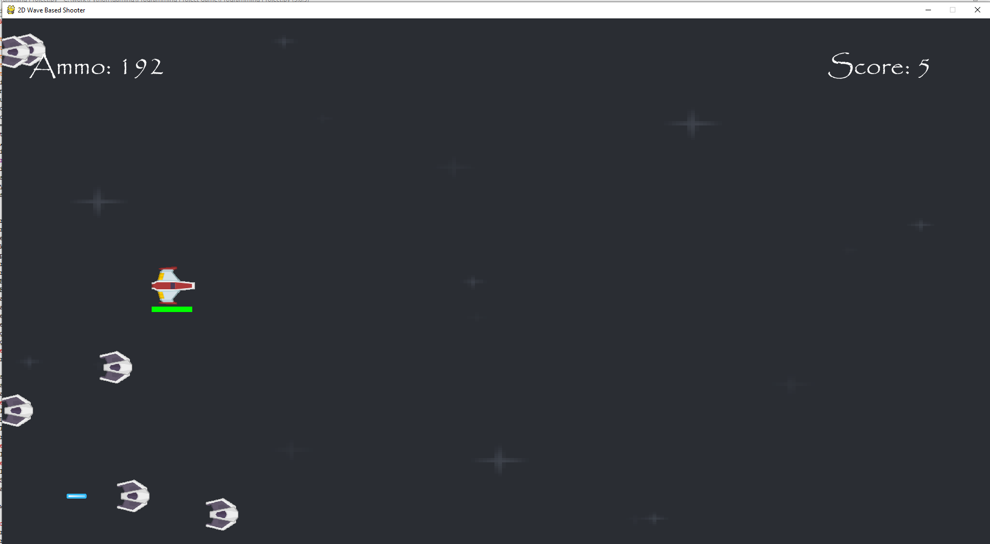
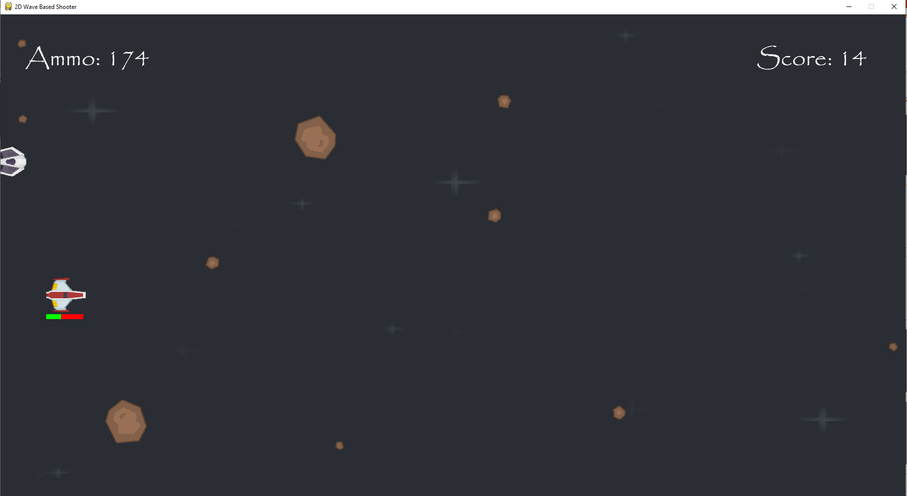
At the start of the game the player’s health bar is shown at the bottom of the screen and is completely green so they have full health.
After the player has collided with a object like a laser or meteor, their health bar becomes redder and the more damage they take, the more the health bar will fill up with red.

Slide 2
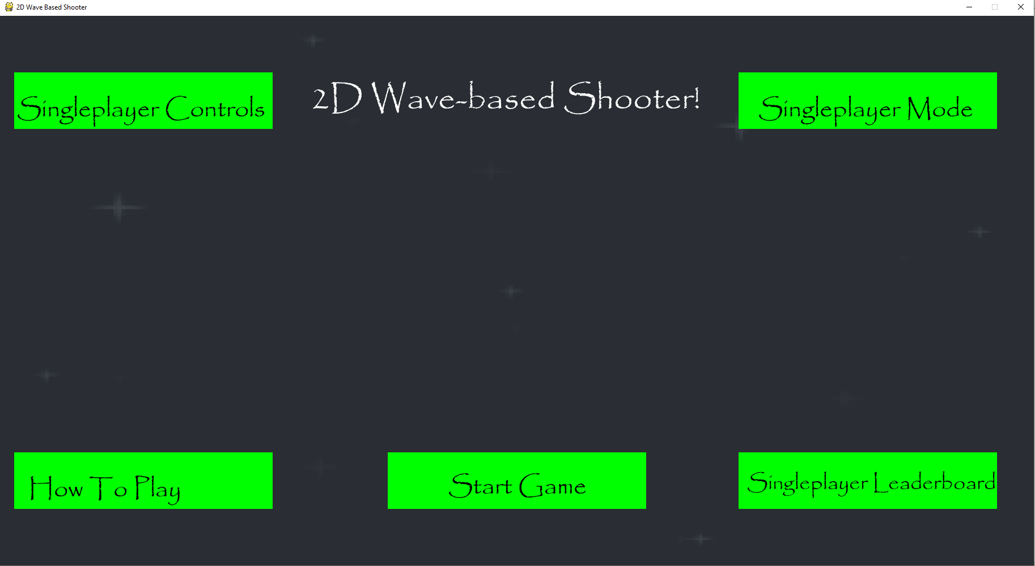
When their health bar becomes completely red, then the player will lose and return to the starting menu.

Slide 3
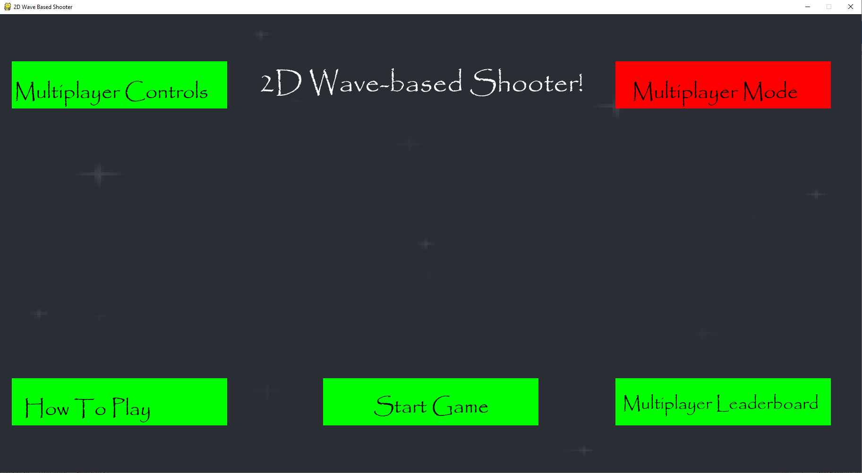
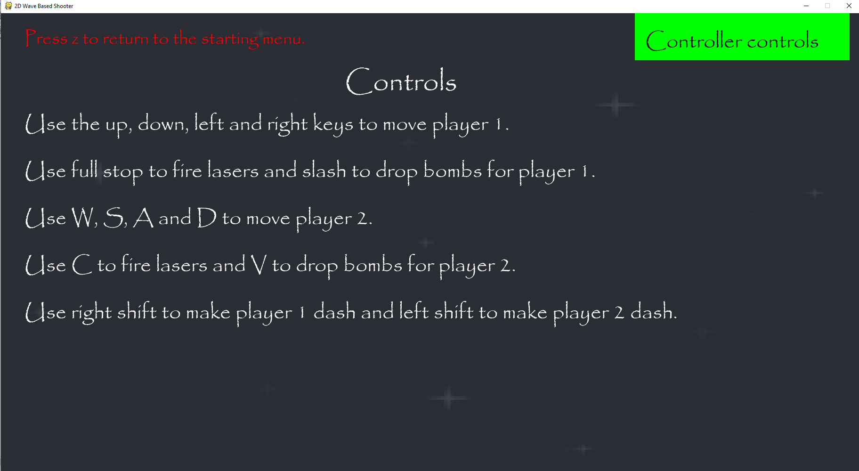
When you click on the box in red the game will go into multiplayer mode from singleplayer.
The game tells you the controls for each player here, these controls are on different sides of the keyboard so two sets of controls have been fit onto it.

Slide 4
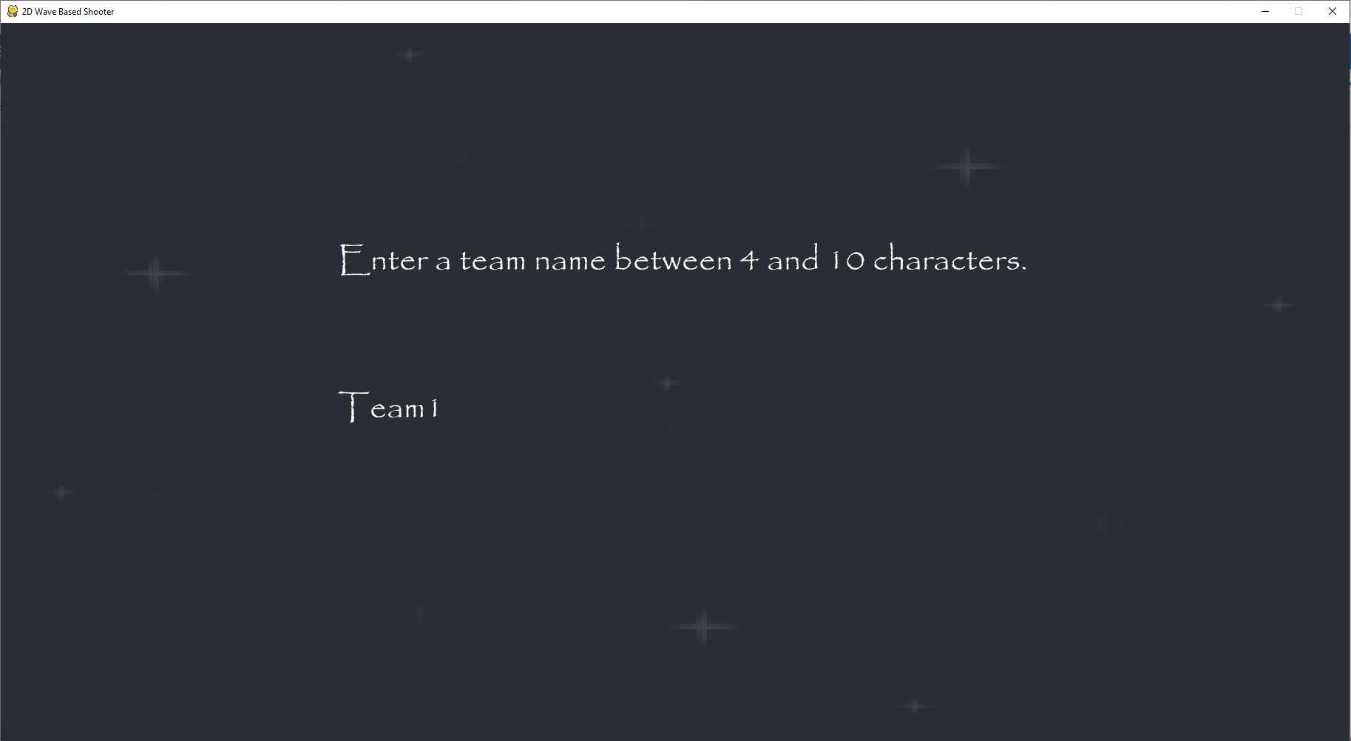
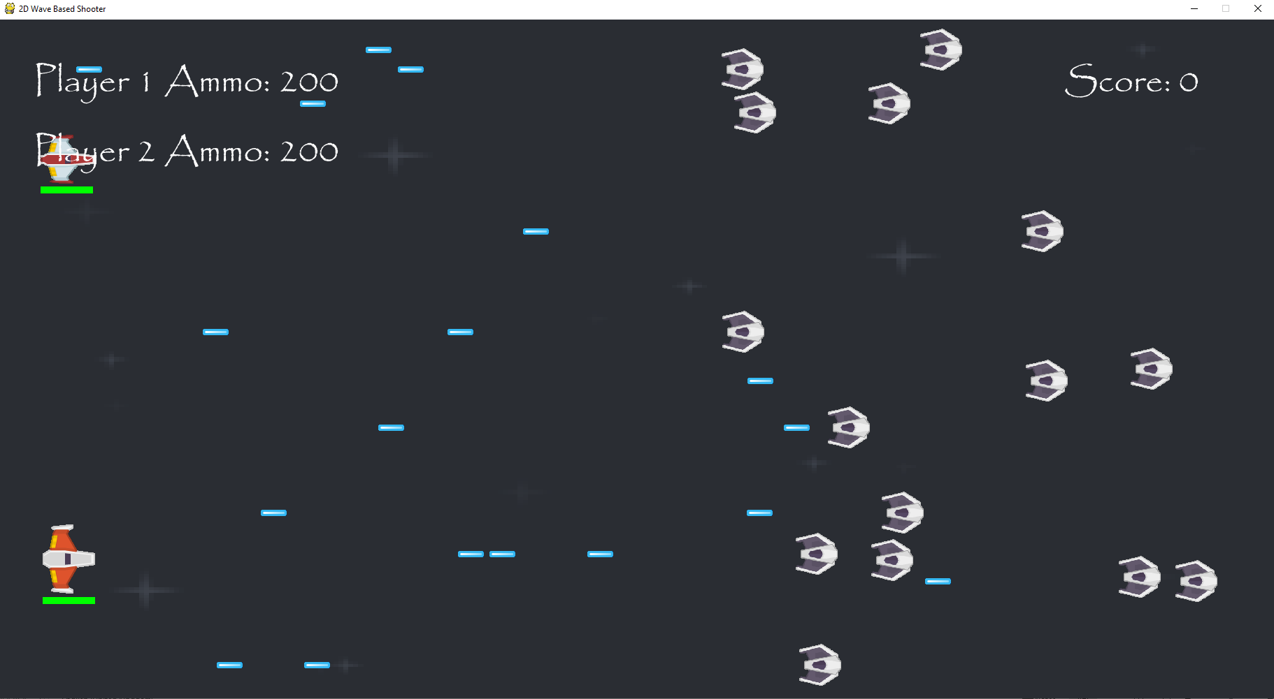
Clicking start Game when in multiplayer mode makes you enter a Team name instead of a player name.
Here, there are two players onscreen when I press enter after entering a team name. The ammo and health bars of both players are shown here as well.

Slide 5
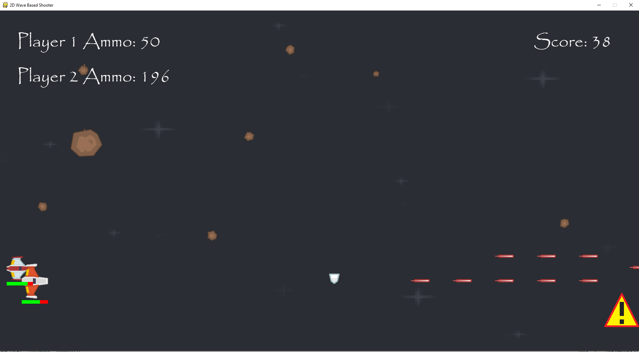
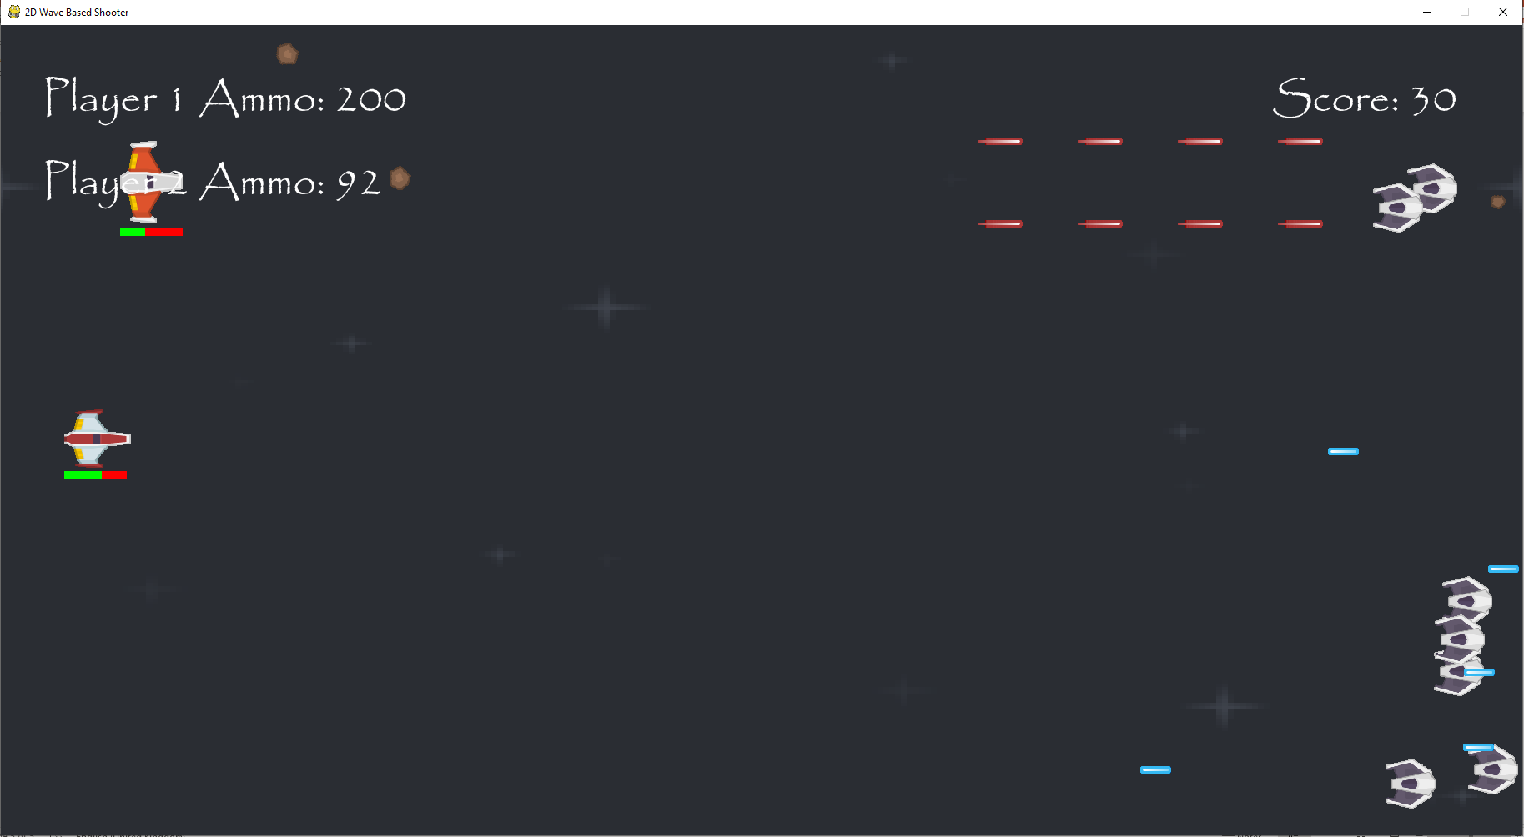
Player 1 can move around and shoot at enemies.
Player 1 loses ammo when they shoot lasers.
Player 2 will lose ammo when they fire they lasers.
Player 2 can also move around and shoot at enemies.
Player 1 also loses health when they collide with enemies or other dangers.
Player 2 will lose health when they collide with enemies or other dangers.

Slide 6
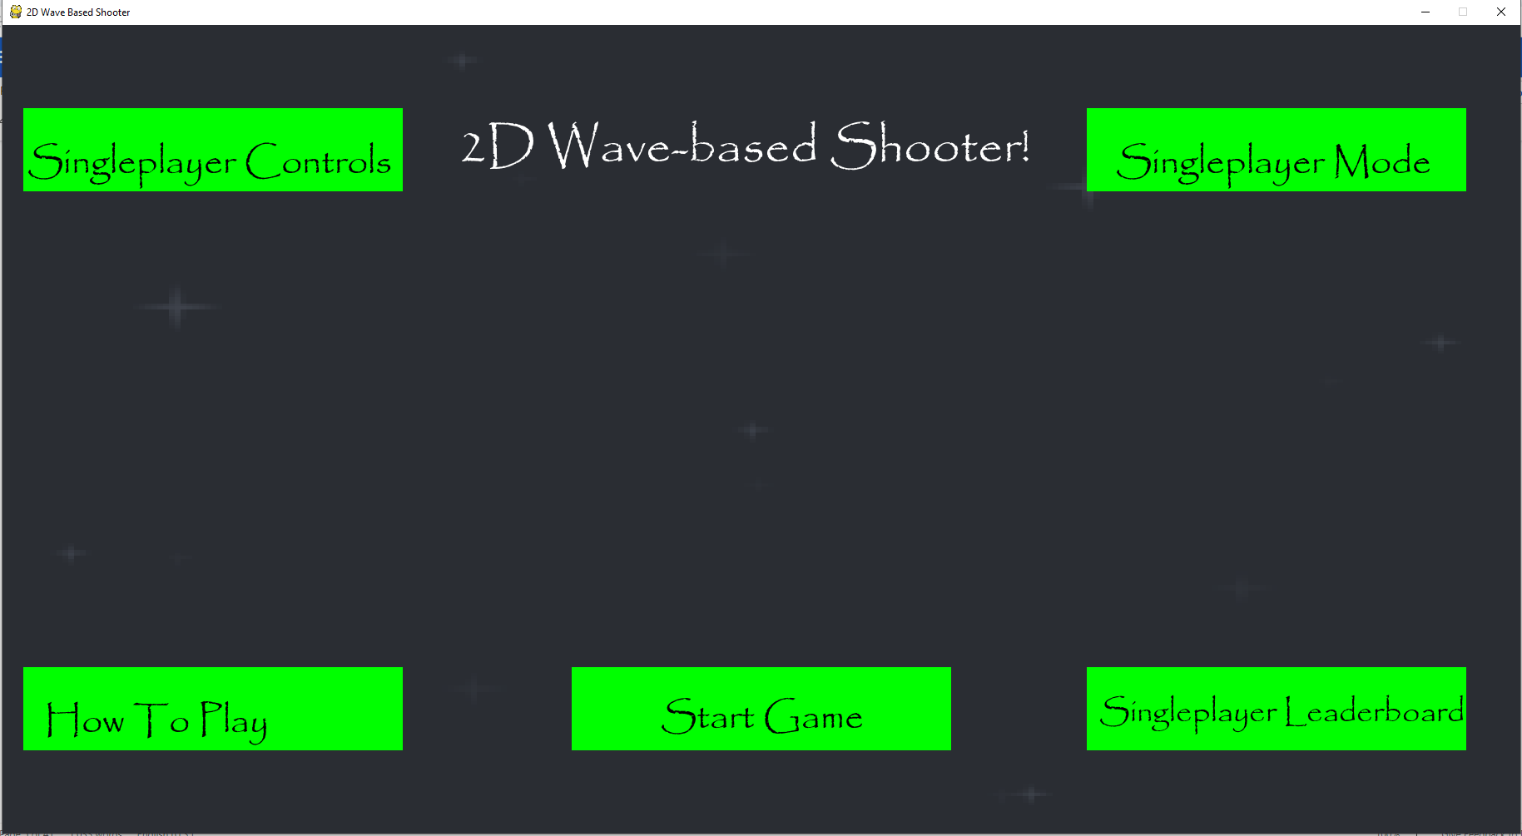
When either player loses all of their health in multiplayer, they return back to the main menu.

Slide 7
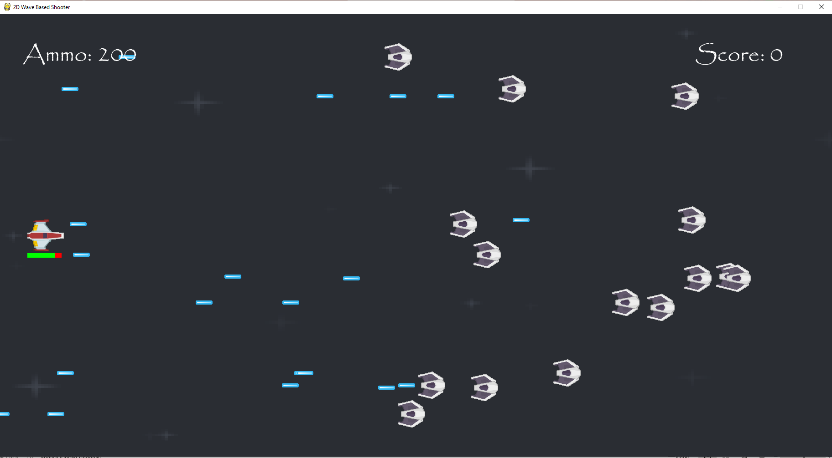
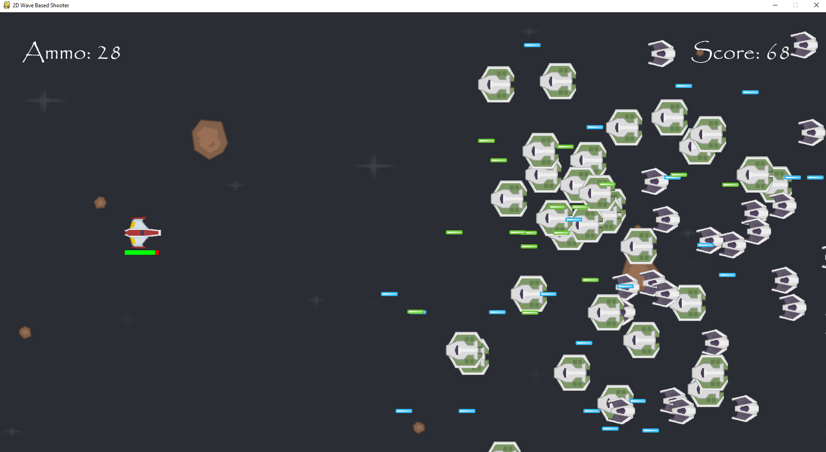
Here are the basic enemies that you face at the start of the game.
Here are the moderate enemies that start attacking you just before the first boss. Its lasers and itself move faster than the previous enemy.

Slide 8
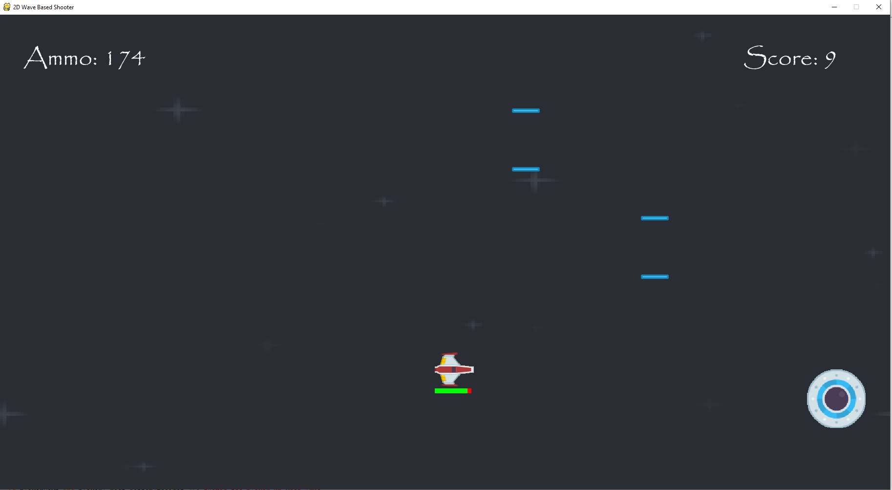
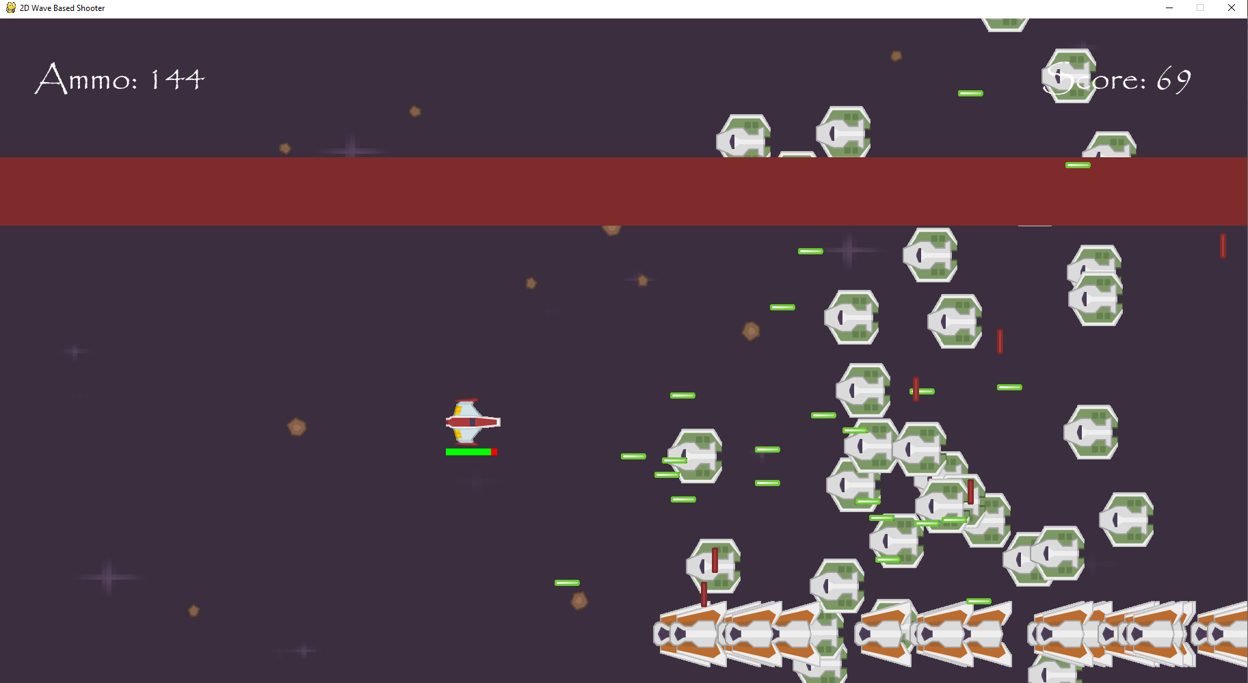
Here is the first boss that you go up against, they use three different moves that are unlock as you make them lose more and more health.
Here are the dropper enemies that attack the player by shooting lasers upwards.

Slide 9
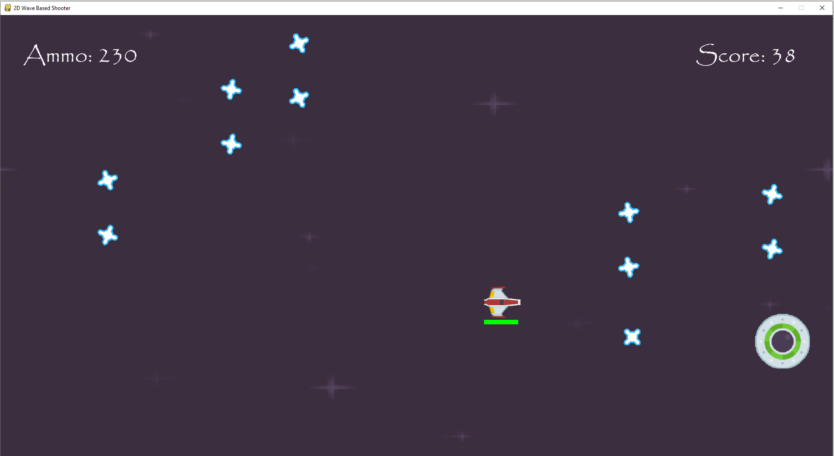
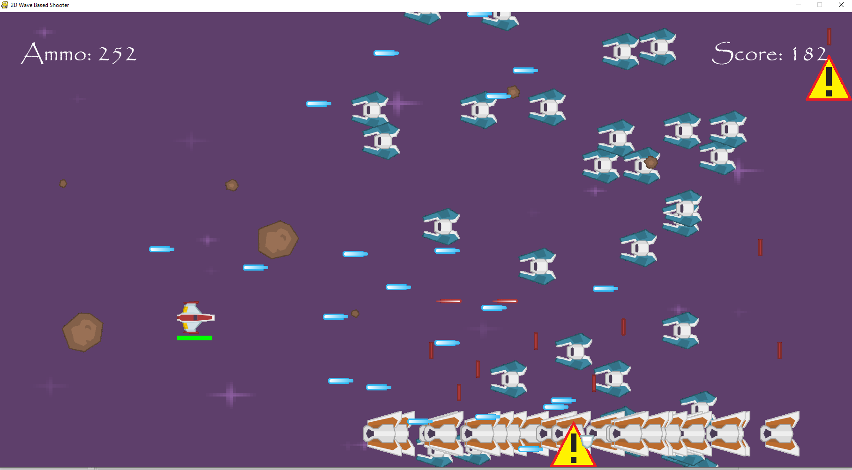
Here is the second boss fight. It has more health than the first and also uses new attacks, with the first one firing two boomerang lasers instead of one.
These are the strong enemies introduced after you beat the second boss fight. They don’t move in straight line and their lasers move faster then the moderate enemies’ ones.

Slide 10
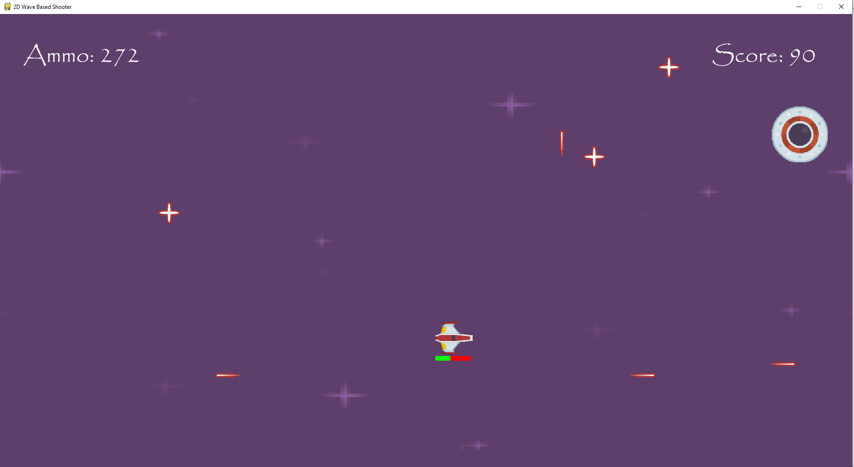
This is the third and final boss of the game. It moves faster than the previous two bosses and uses different attacks, with this first attack being a laser star that splits into four different lasers, moving up, down, left and right.

Slide 11
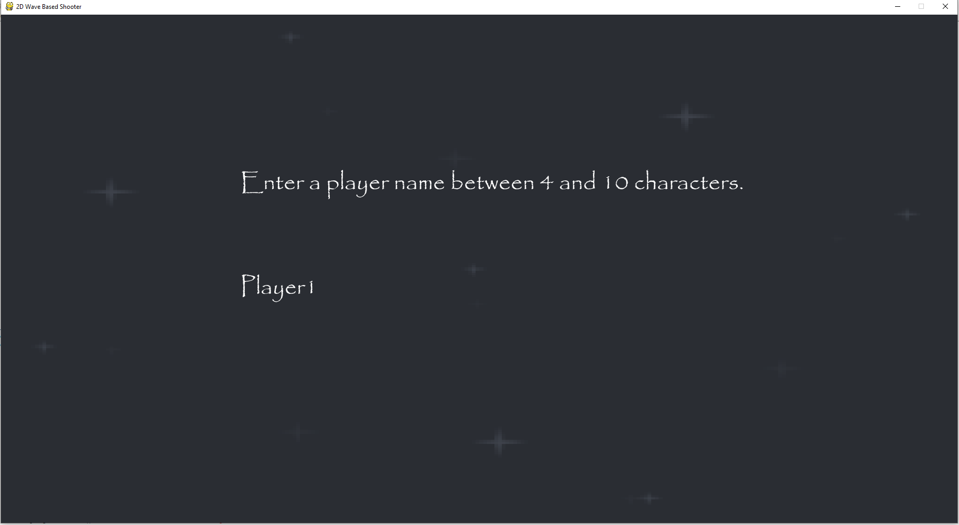
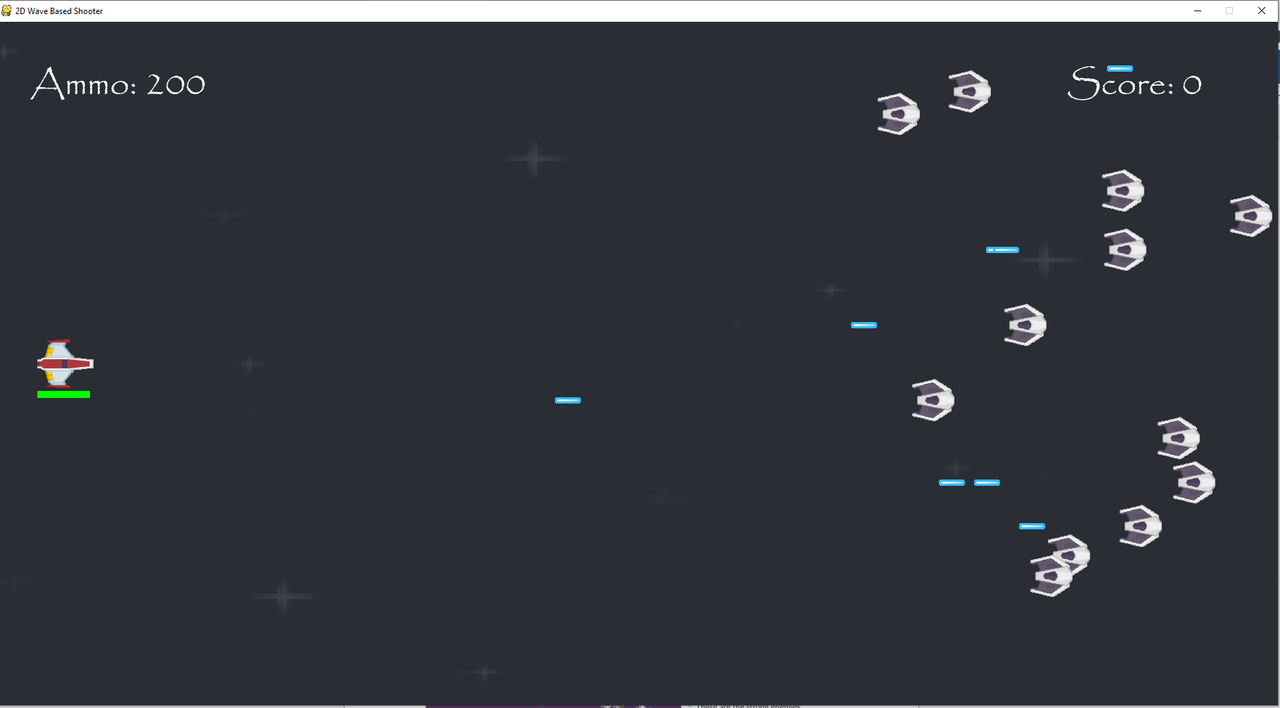
Here is the name being entered at the start of the game, this will correspond with the player score later on.
At the start of my game the score is 0.

Slide 12
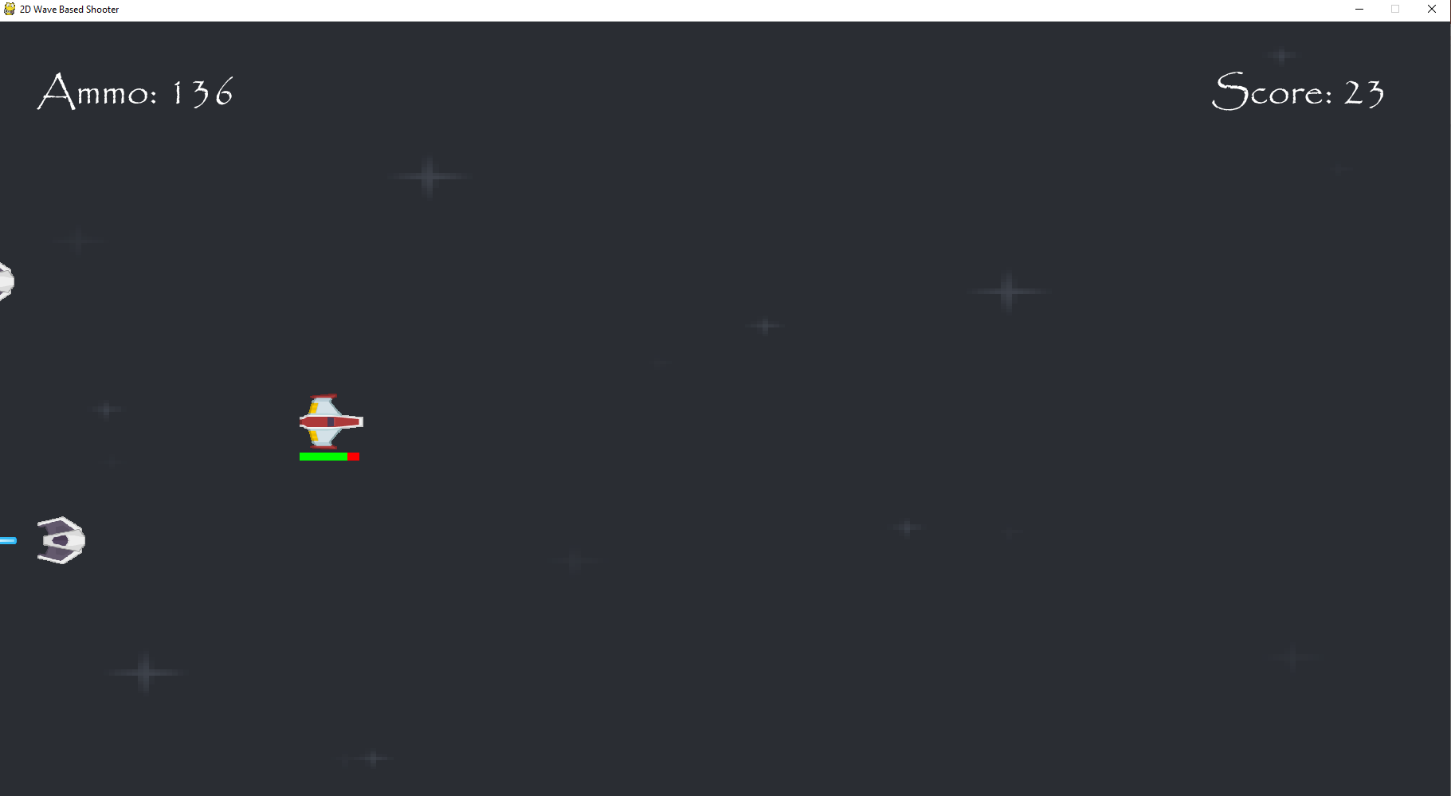
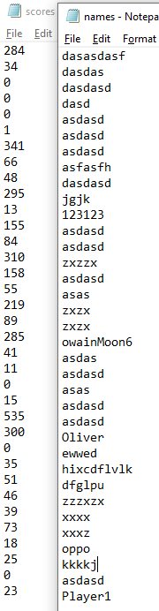
Whenever I shoot the enemy, my score goes up by 1. 23 is the score that I have before I lose all of my health.
The most recent name and score in the files are Player1 and 23, so the player name and corresponding score were saved.

Slide 13
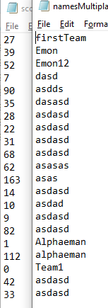
There are similar corresponding names and scores for the names and score in the multiplayer files.

Slide 14
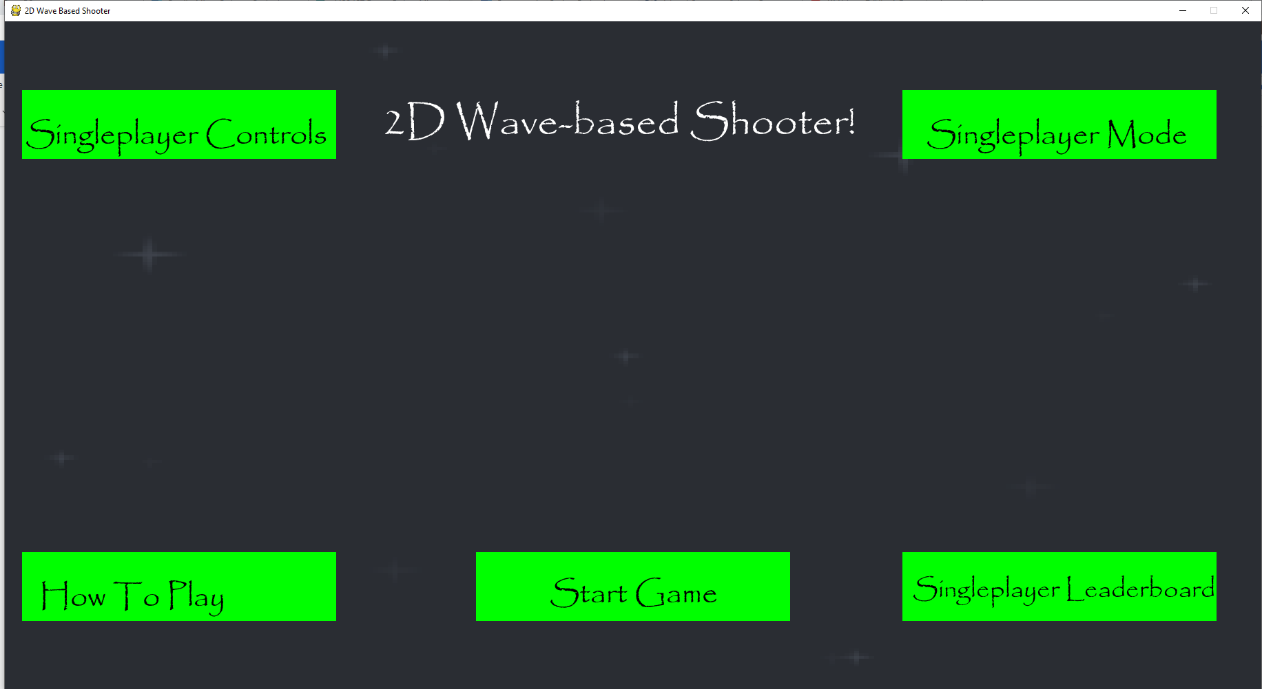
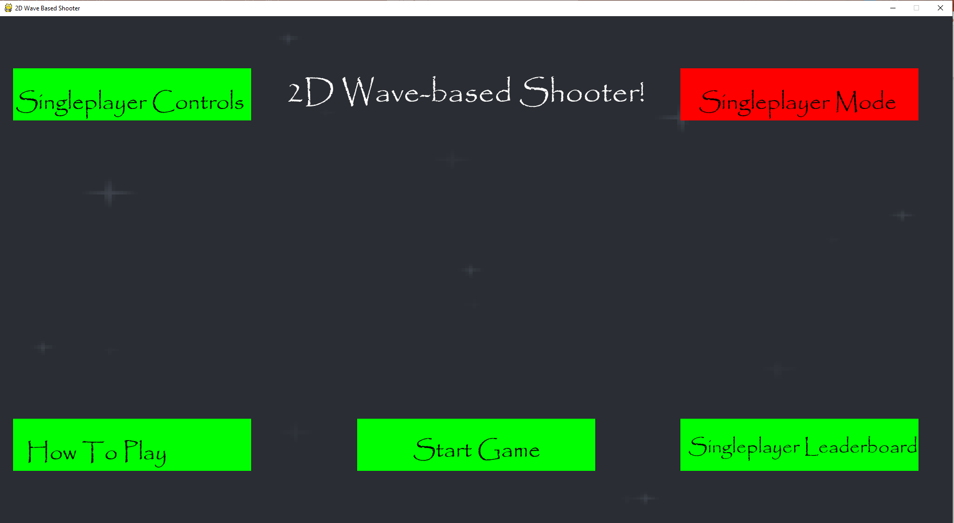
Here is the main menu of the 2D shooter. The layout of this main menu is consistent here because all of the boxes for the different sections have the same colour and all of the text is written in the same font.
When a mouse hovers over any of the boxes, they turn red to represent that they can be clicked on.

Slide 15
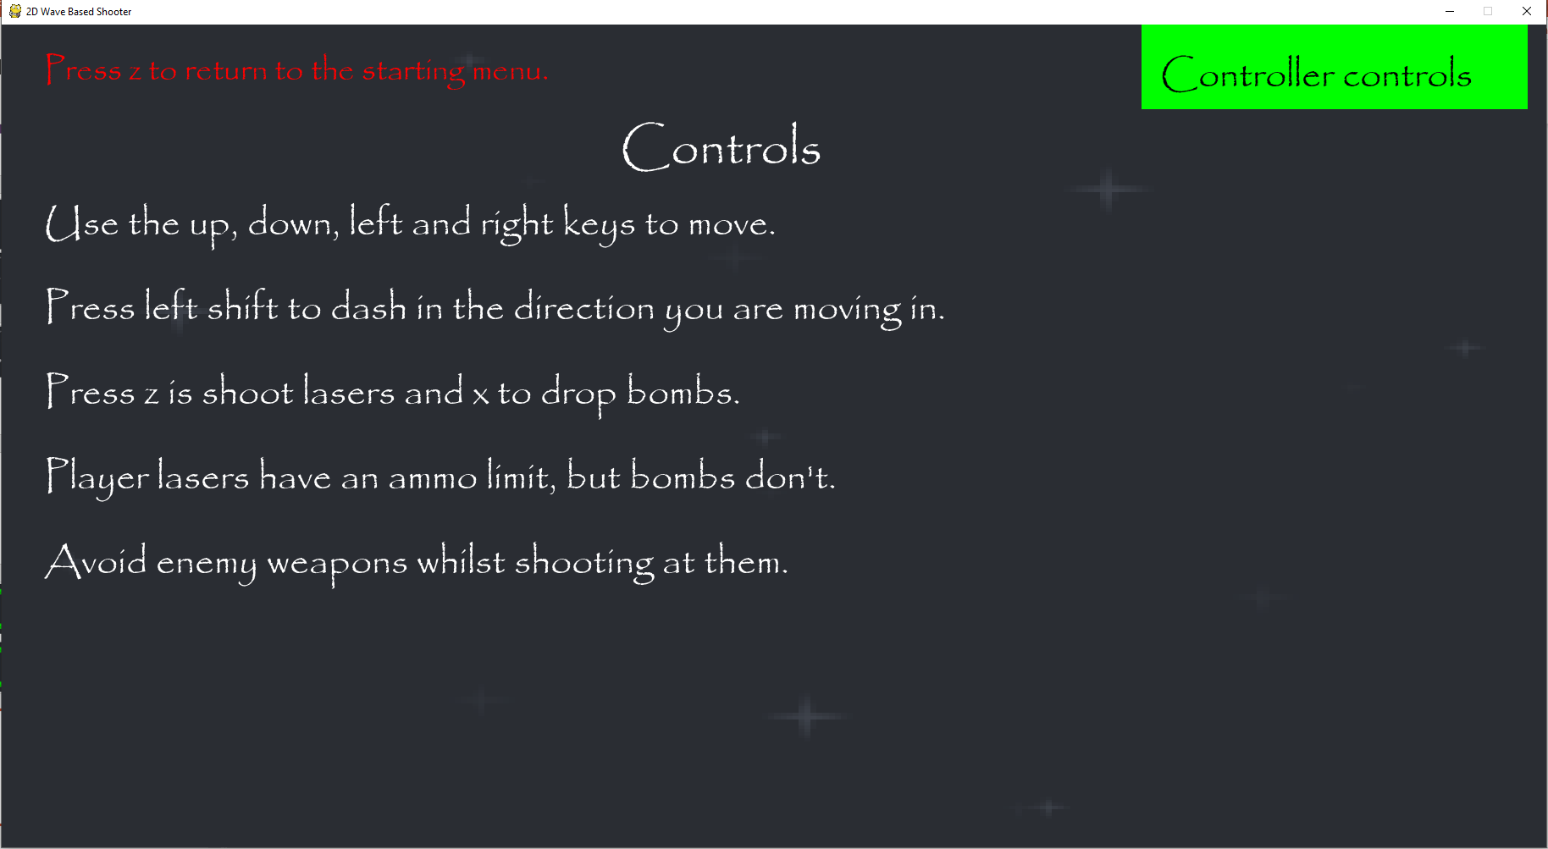
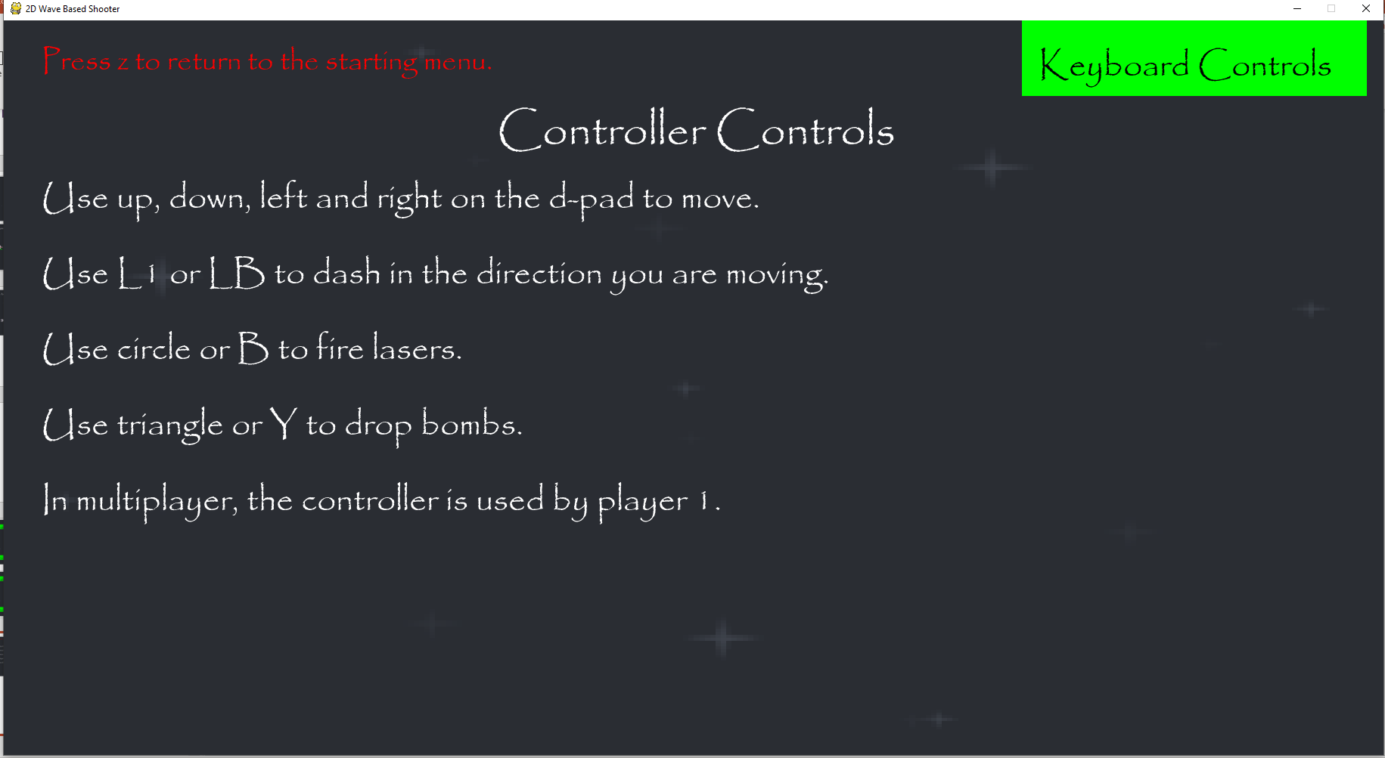
Clicking on the Controls section takes the player here where they can look at the controls and also go to another section to look at the controller controls.
Clicking on controller controls in the top-right hand corner of the screen lets the player look at the controls if they are using a controller. They can also return to the keyboard controls section if they want to.

Slide 16
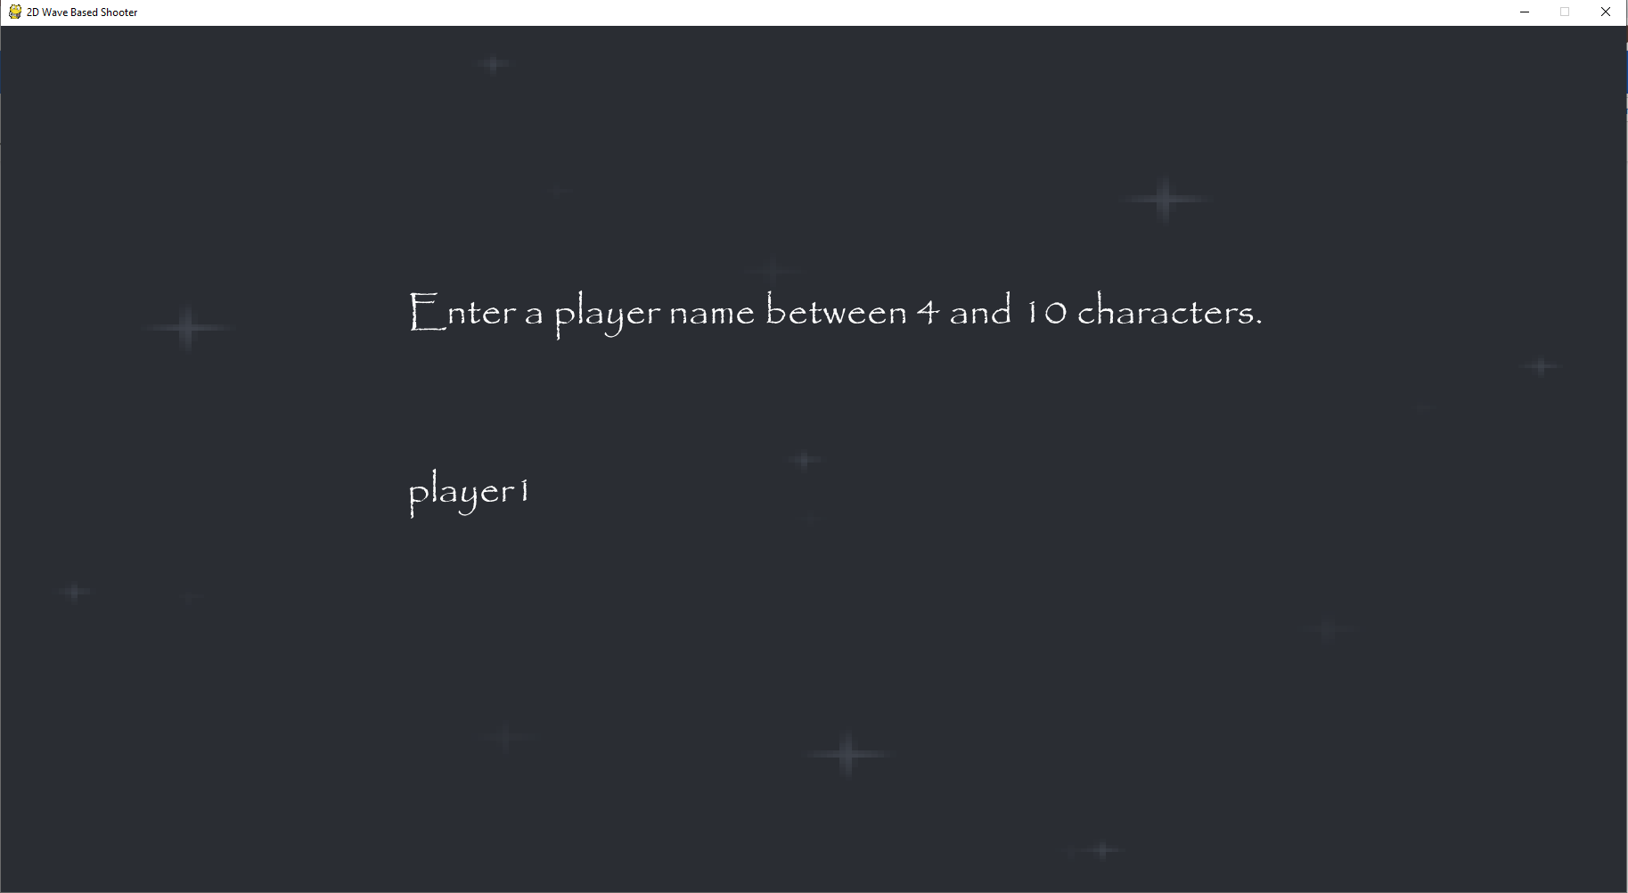
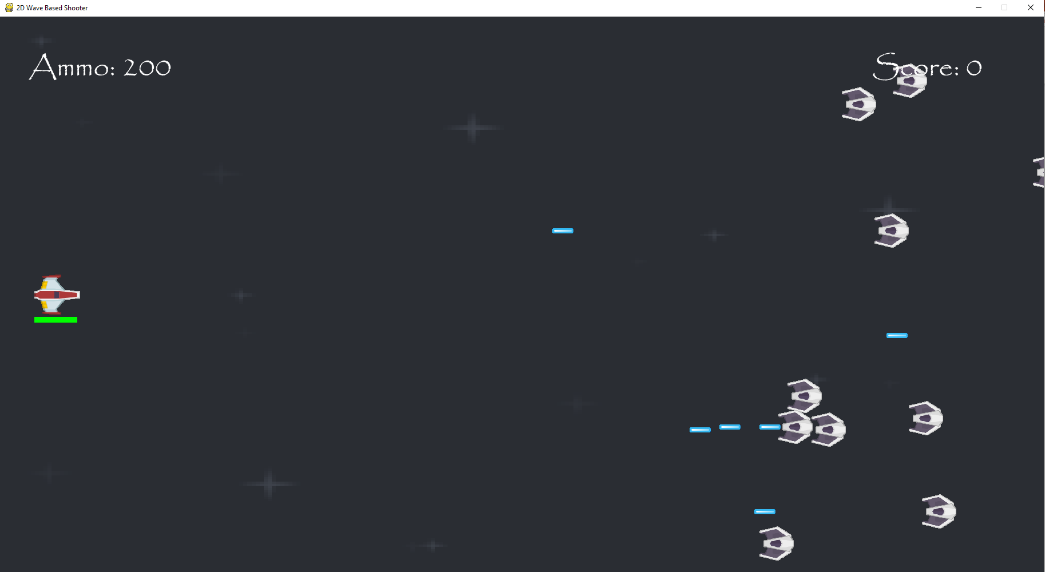
Clicking on start game in the main menu takes the player to this screen where they enter a player name.
Pressing enter after entering a username lets the player start the game.

Slide 17
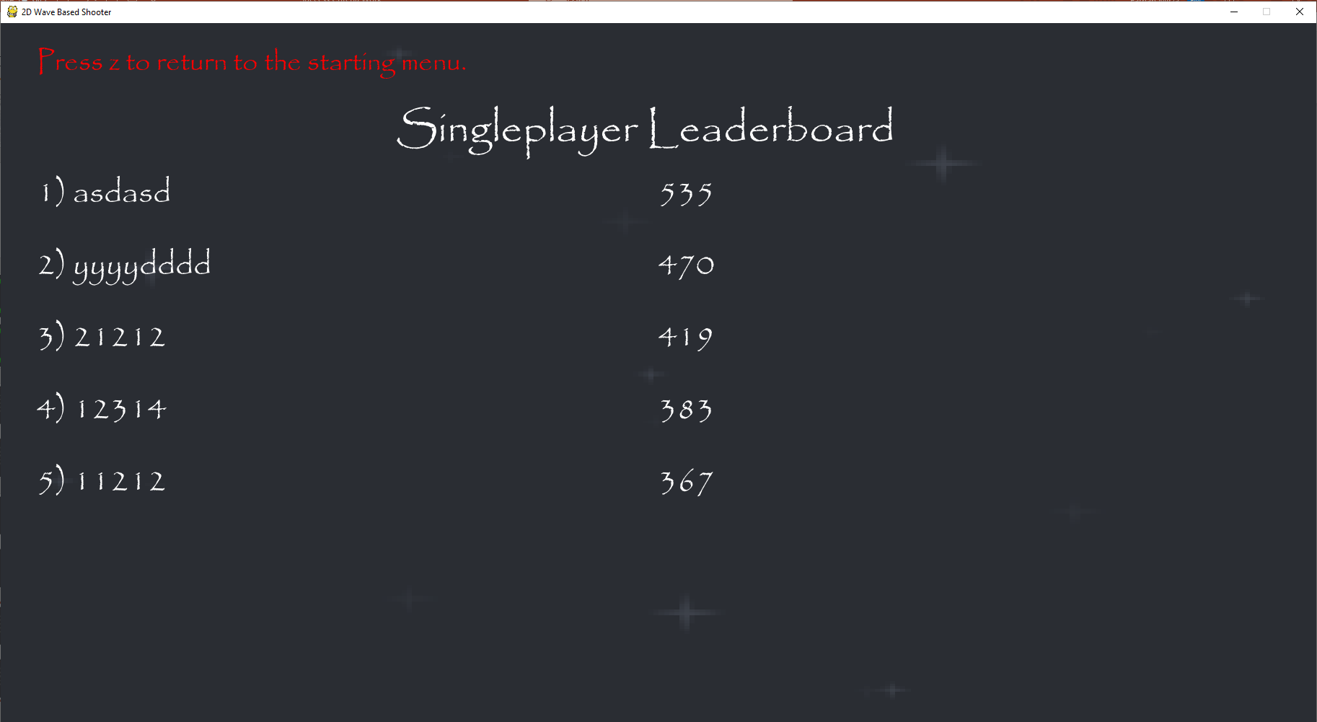
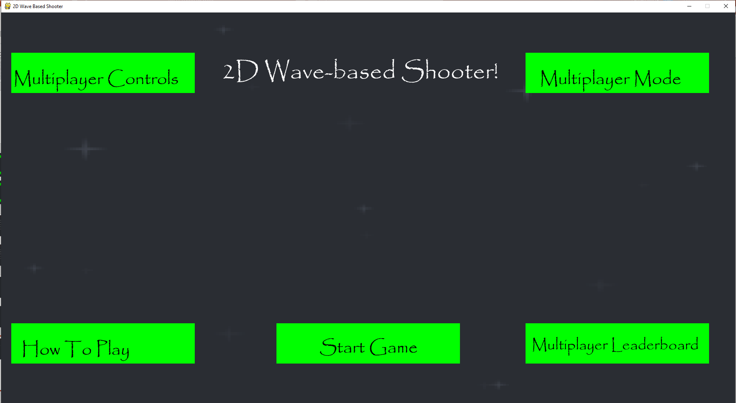
Clicking on Singleplayer Leaderboard on the main menu lets the player see the top five players of the game at singleplayer
Clicking on singleplayer mode in the top right of the screen changes the game into a multiplayer mode, with a different leaderboard and controls.

Slide 18
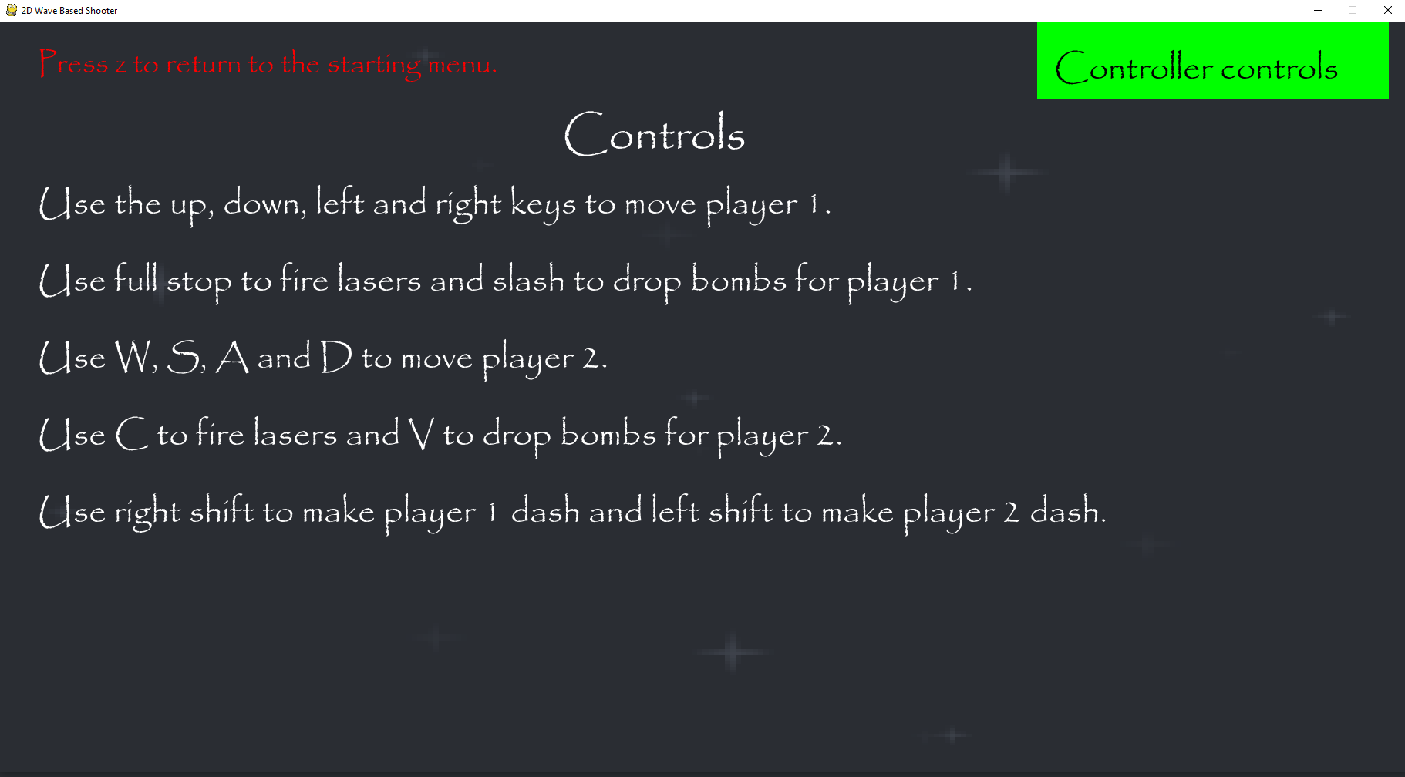
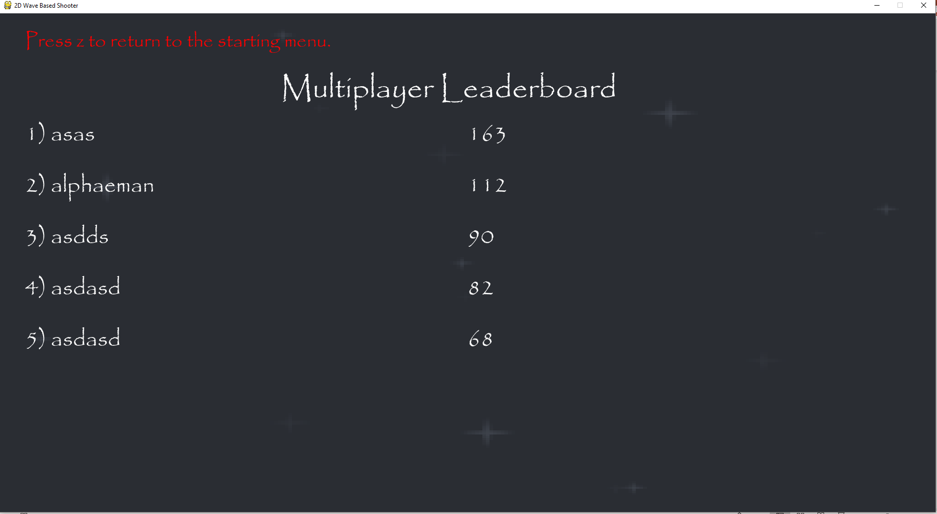
These are the controls when the game is in multiplayer mode. You can still view controller controls from here.
This is the leaderboard when the game is in multiplayer. It uses scores and names that are stored in different files when the game ends.

Slide 19
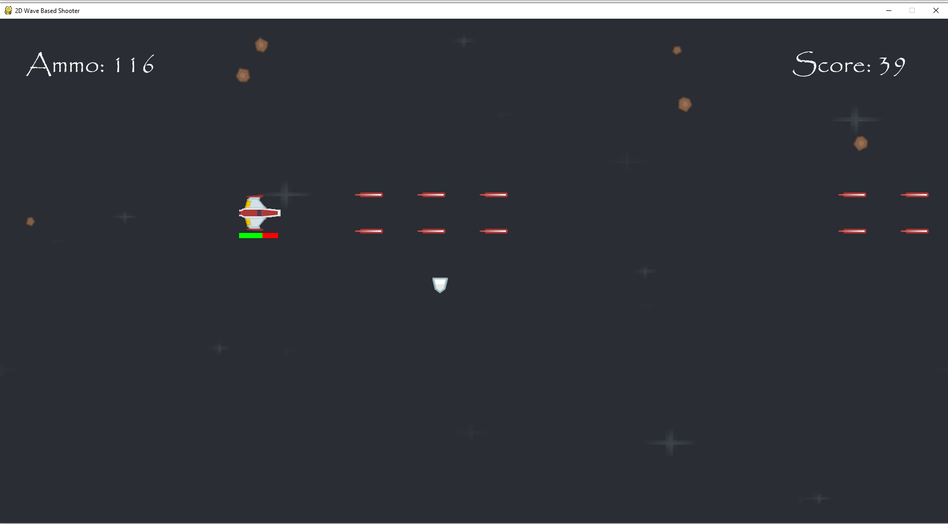
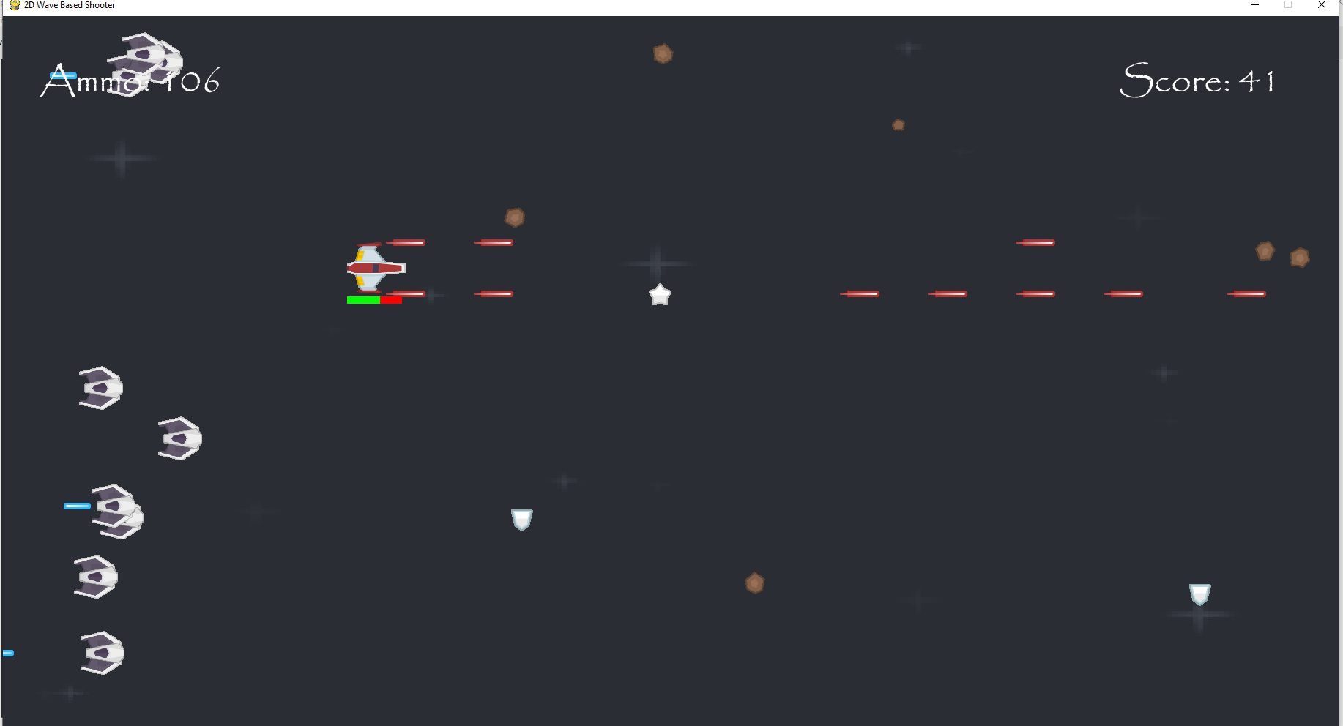
A shield powerup was dropped from a meteor that I had destroyed and picking it up would cause me to regain health.
In this image, there is both the shield and star powerup. The star powerup gives the player 50 ammo back or up to the maximum ammo of ammo they can have.

Slide 20
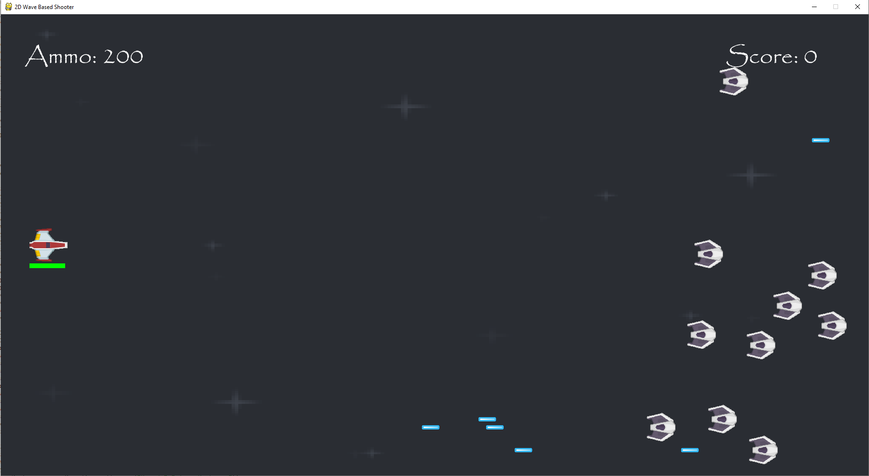
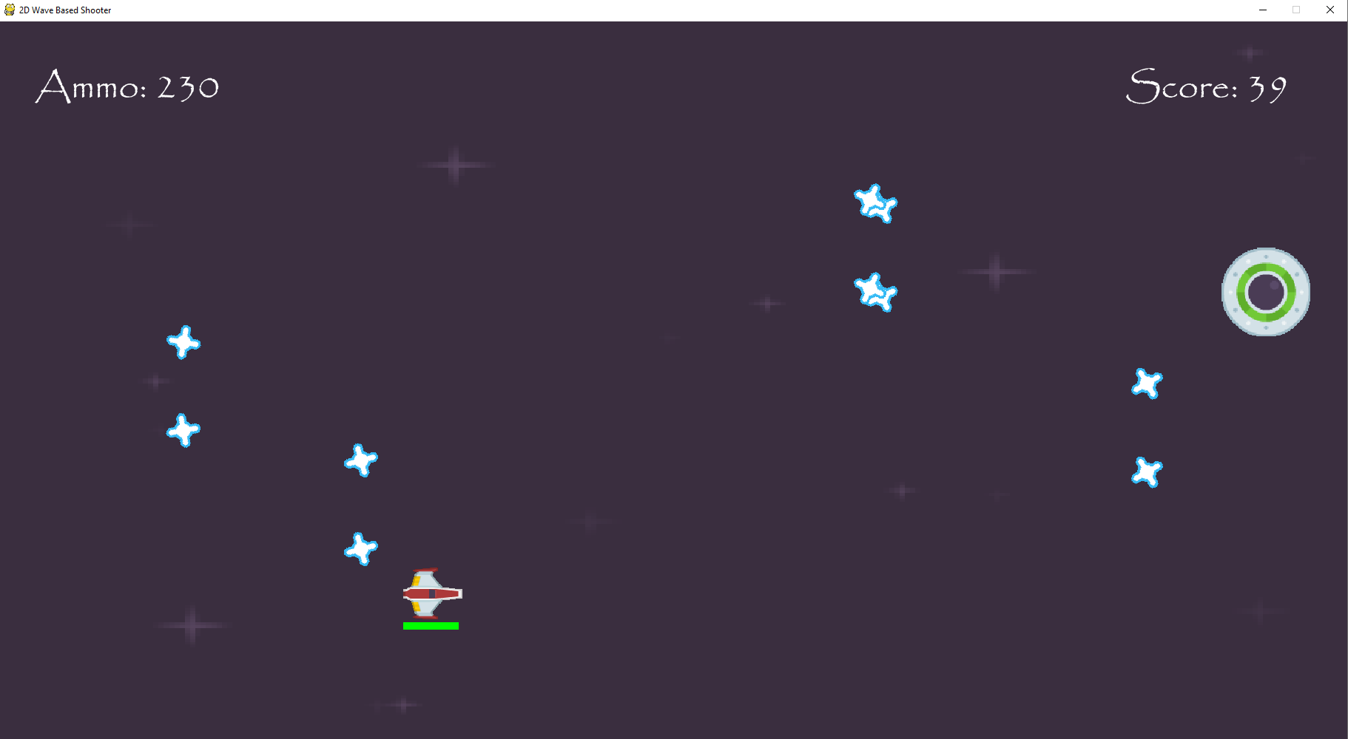
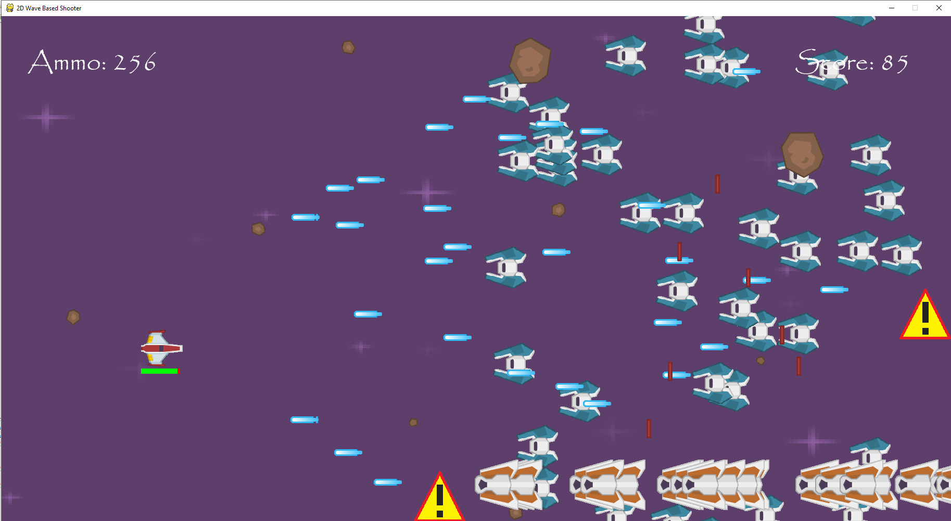
Here is the background of the game at the start of the game.
Here is the background of the game during the second phase during the second boss. It has become a dark purple colour.
Here is the background of the game during the third phase of the game after the second boss is defeated. It has now become a much brighter purple.

Slide 21
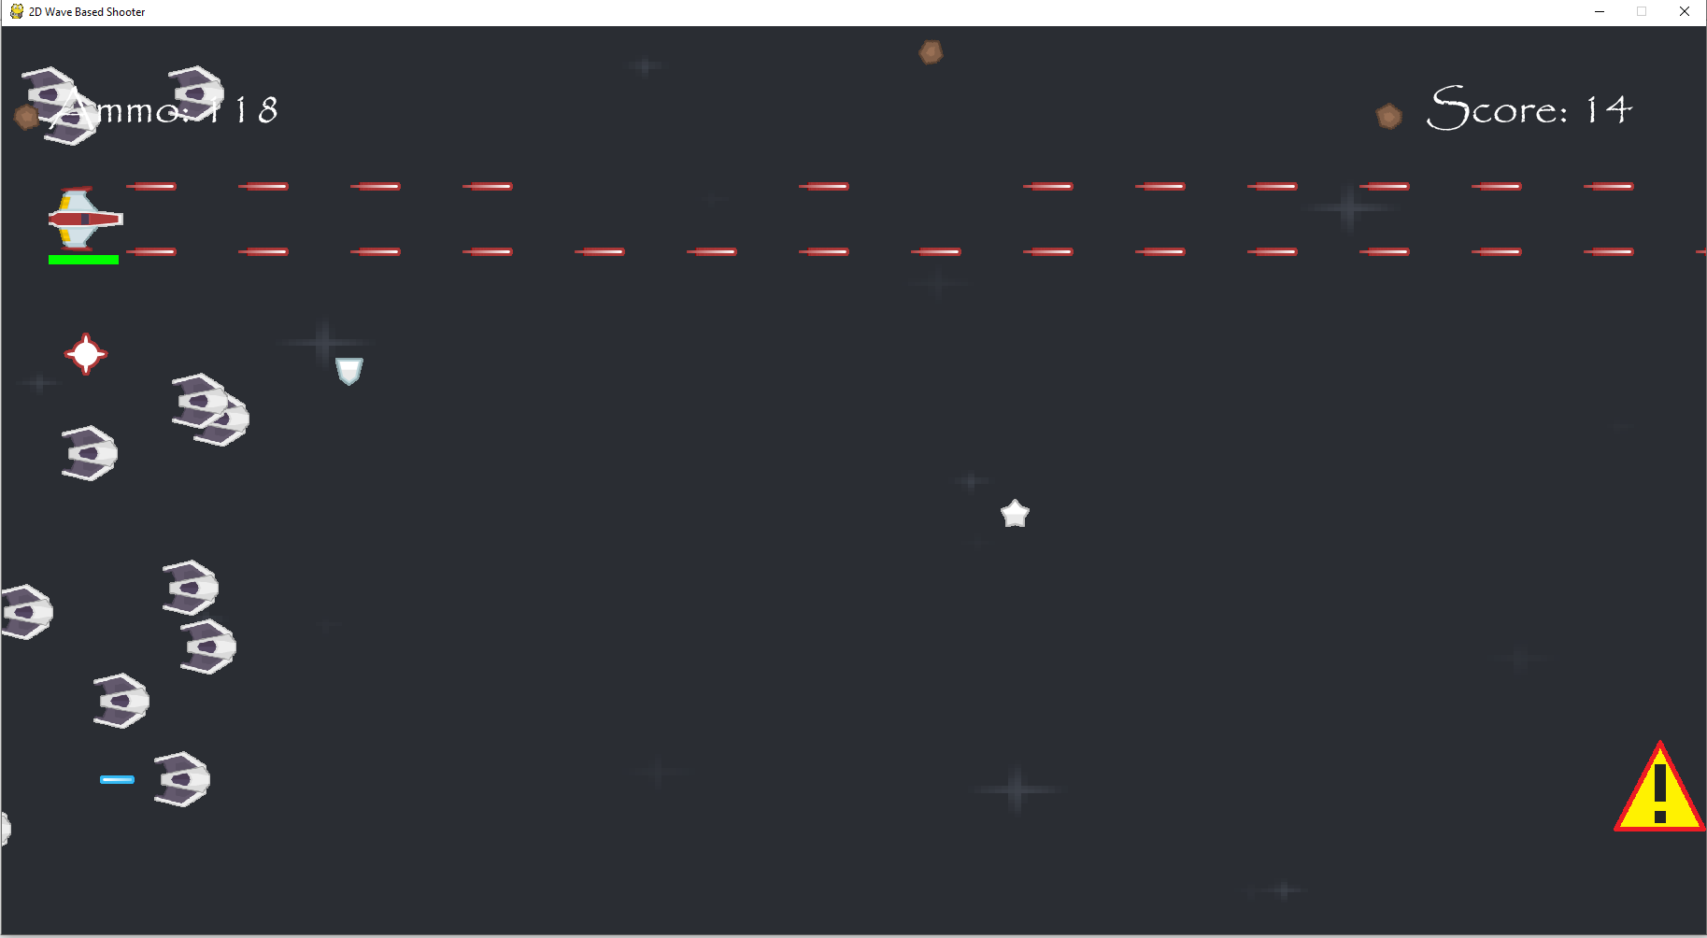
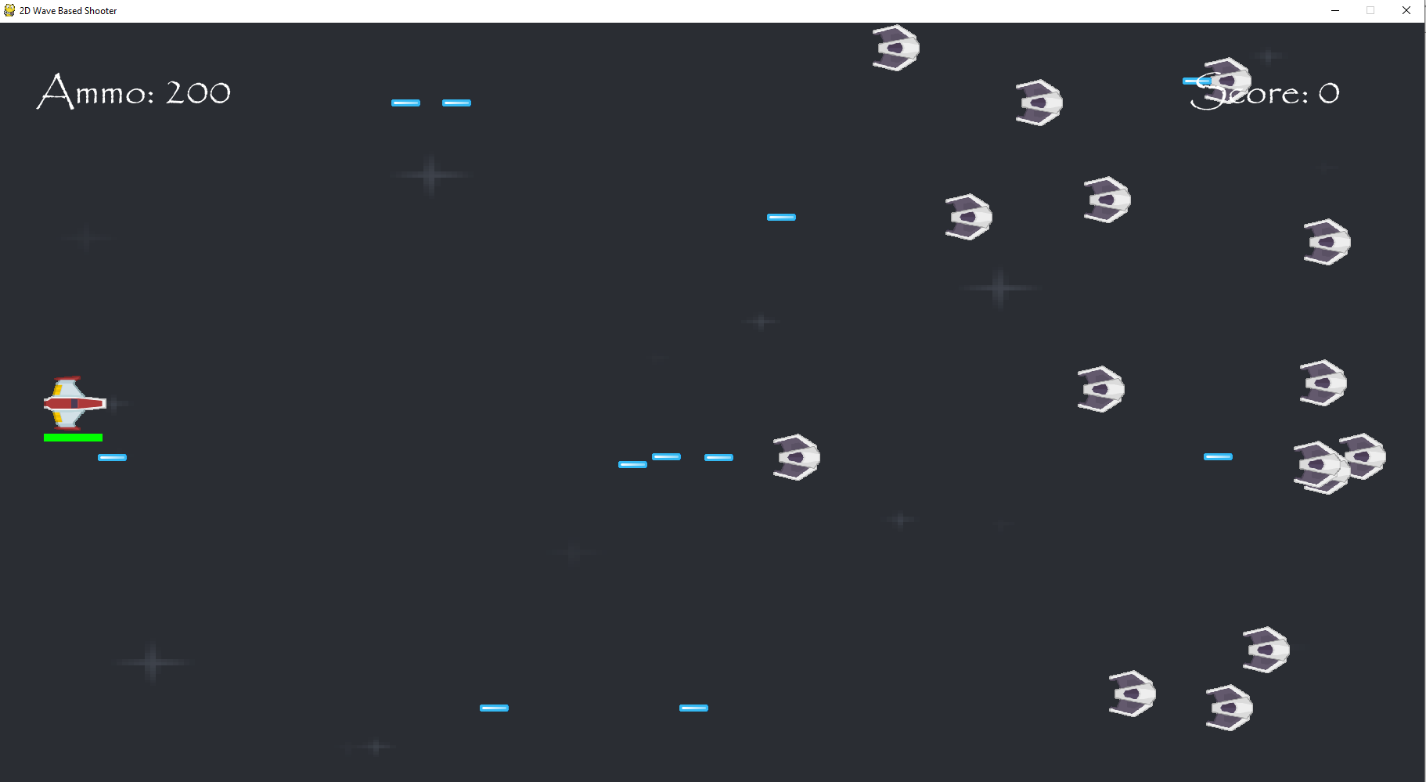
The lasers being fired and the bomb being dropped are caused me pressing circle and triangle on the controller respectively.
Here is my spaceship at the start of the game.

Slide 22
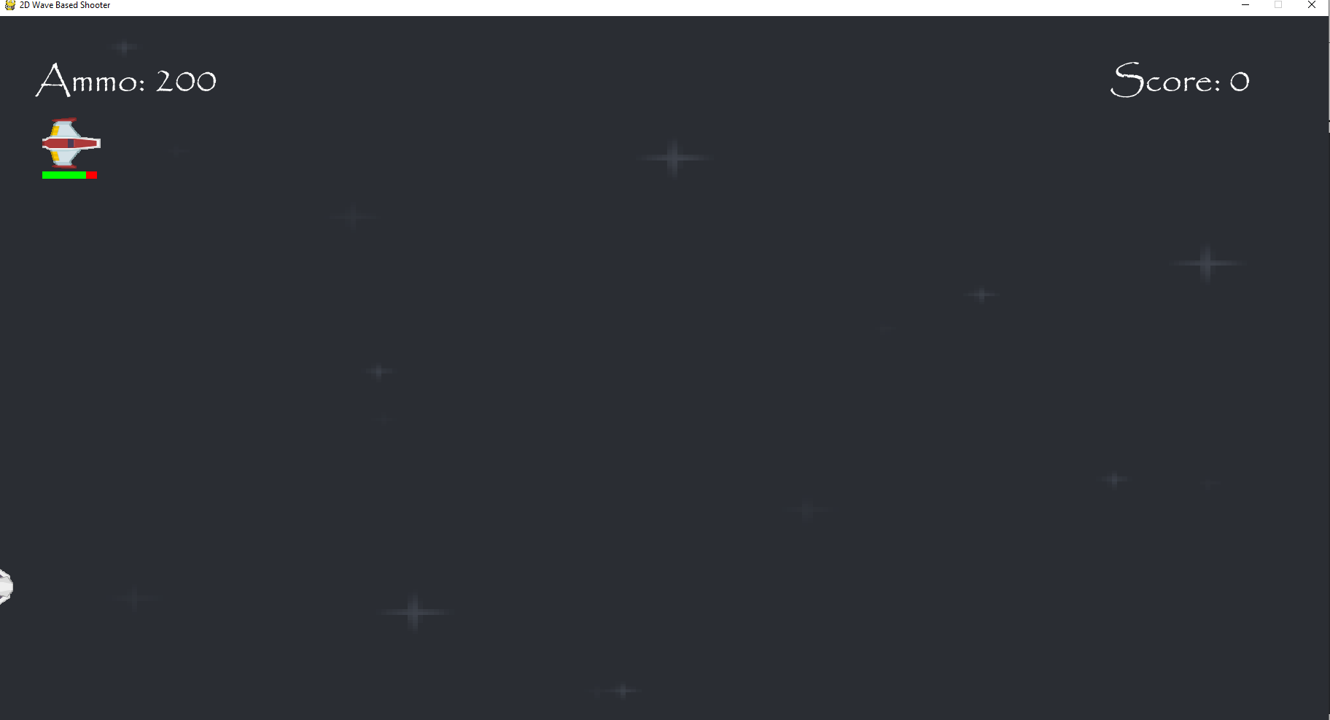
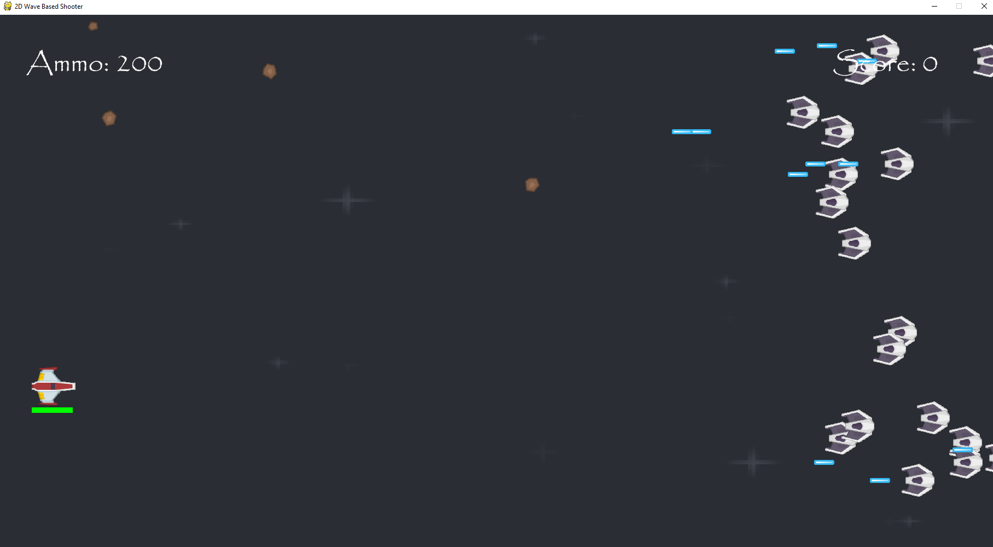
When I press up on the d-pad, the spaceship moves up.
When I press down on the d-pad, the spaceship moves down.

Slide 23
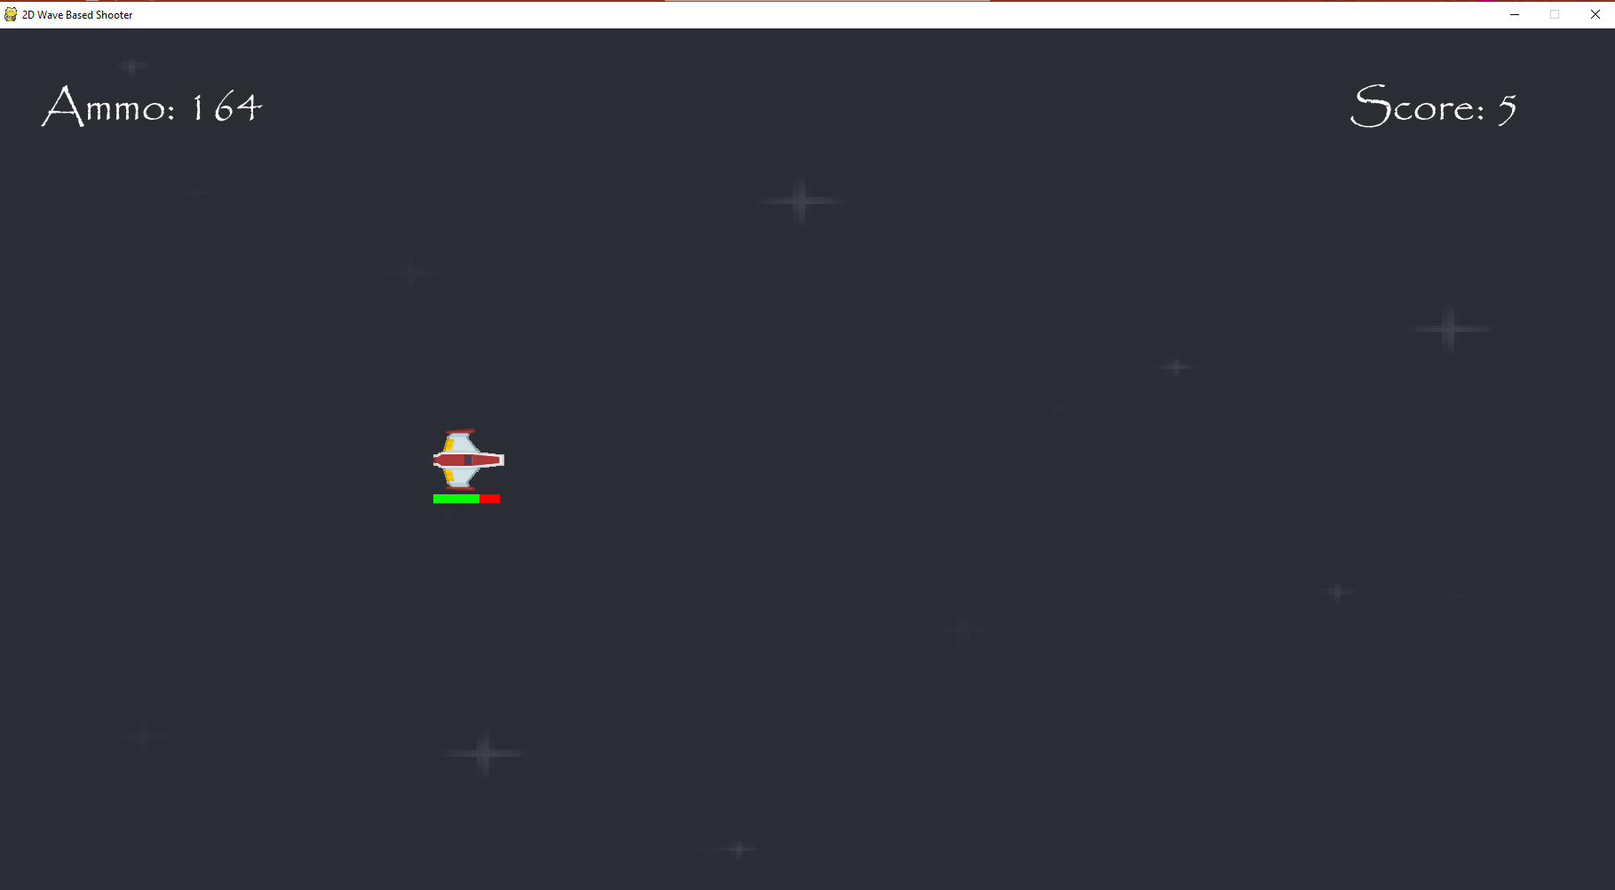
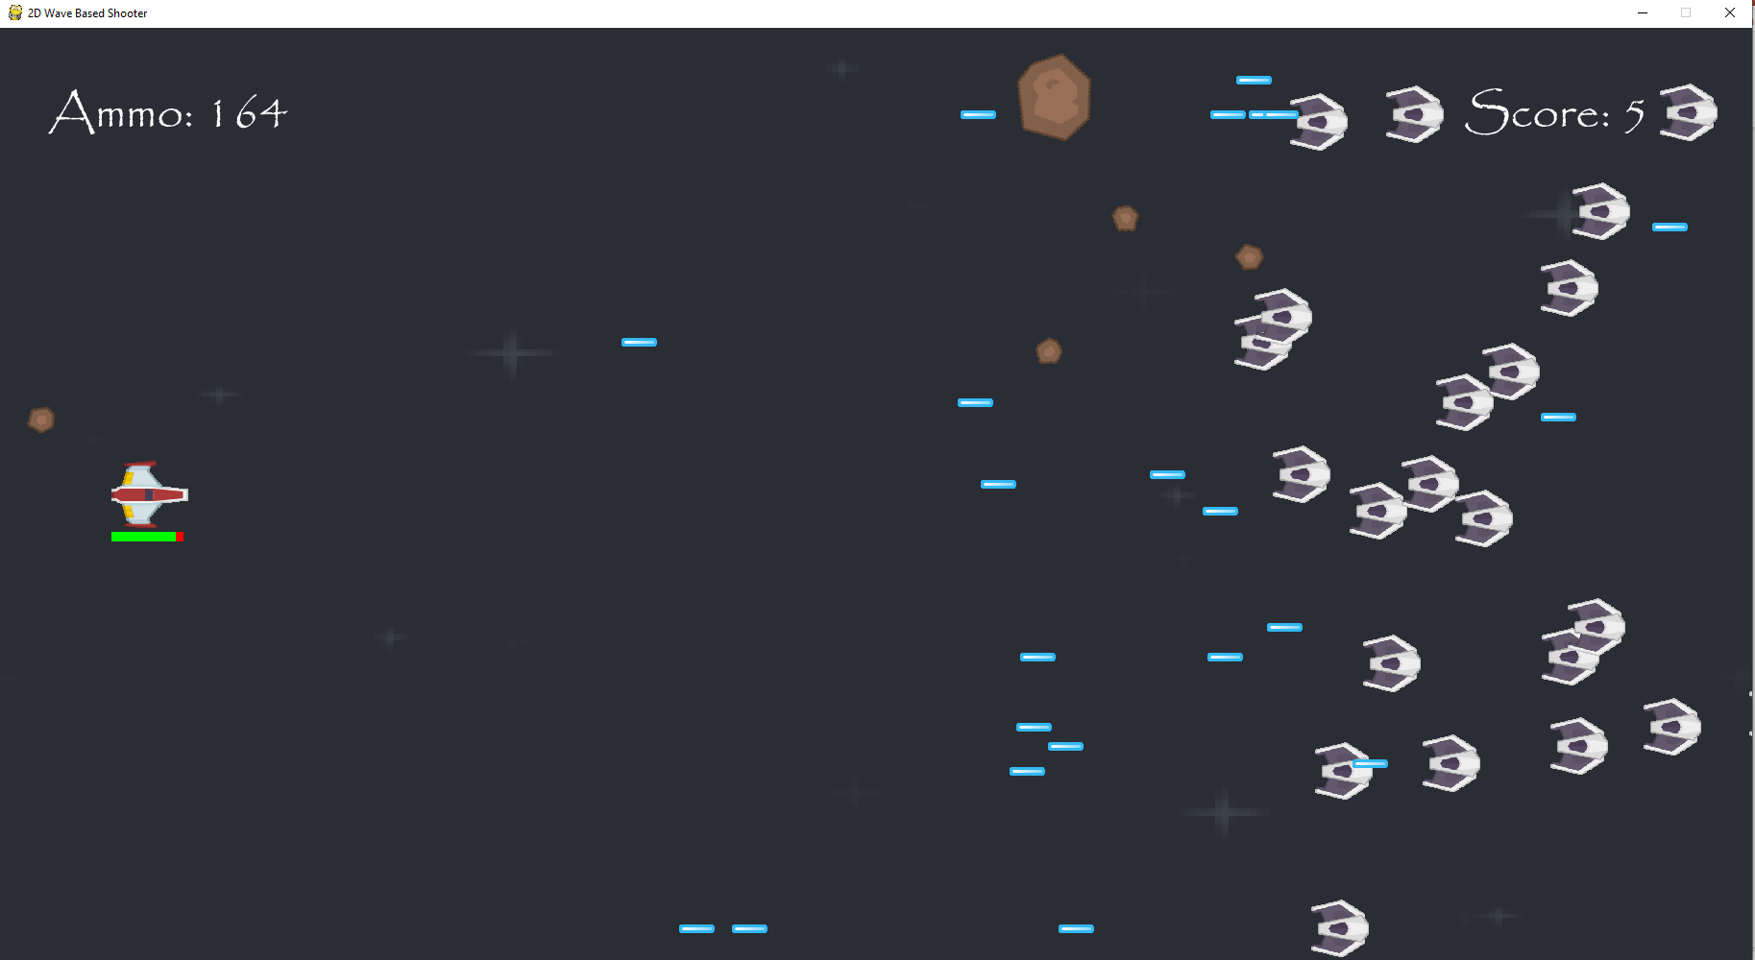
When I press right on the d-pad, the spaceship moves right.
When I press left on the d-pad, the spaceship moves left.

